Slide 1


ArcGIS API for Python for Data Scientists
Andrew Chapkowski
Alberto Nieto
2018 Esri Developer Summit DC

Slide 2

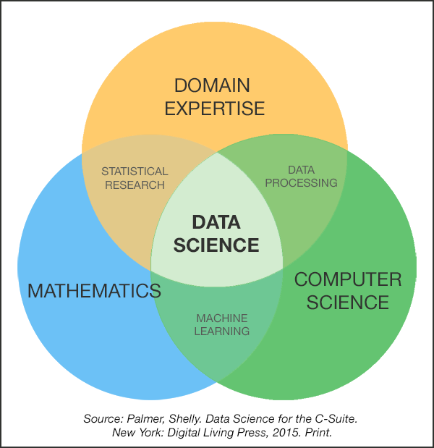

Slide 3
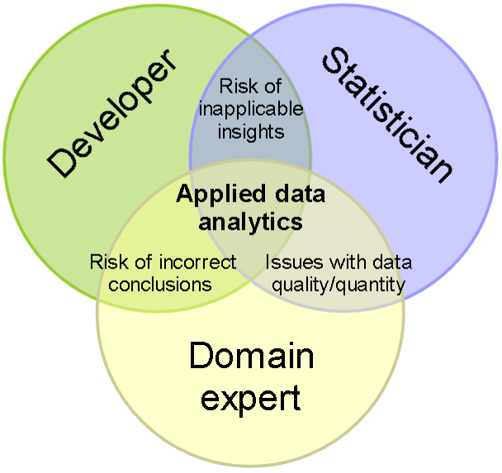

Slide 4
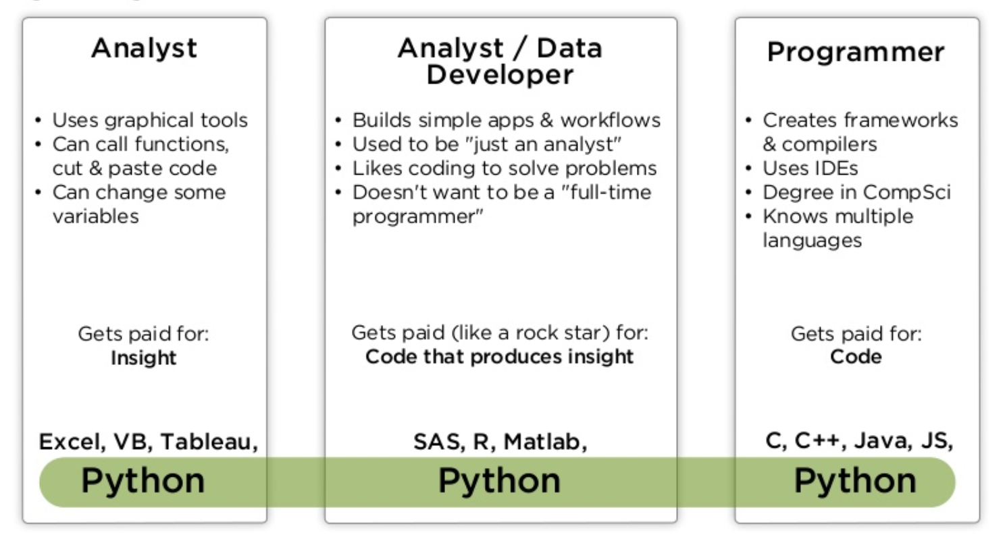
Analysts, Data Scientists and Developers
Source: PyCon India 2018 Python And Data: Past, Present And Future By Peter Wang

Slide 5
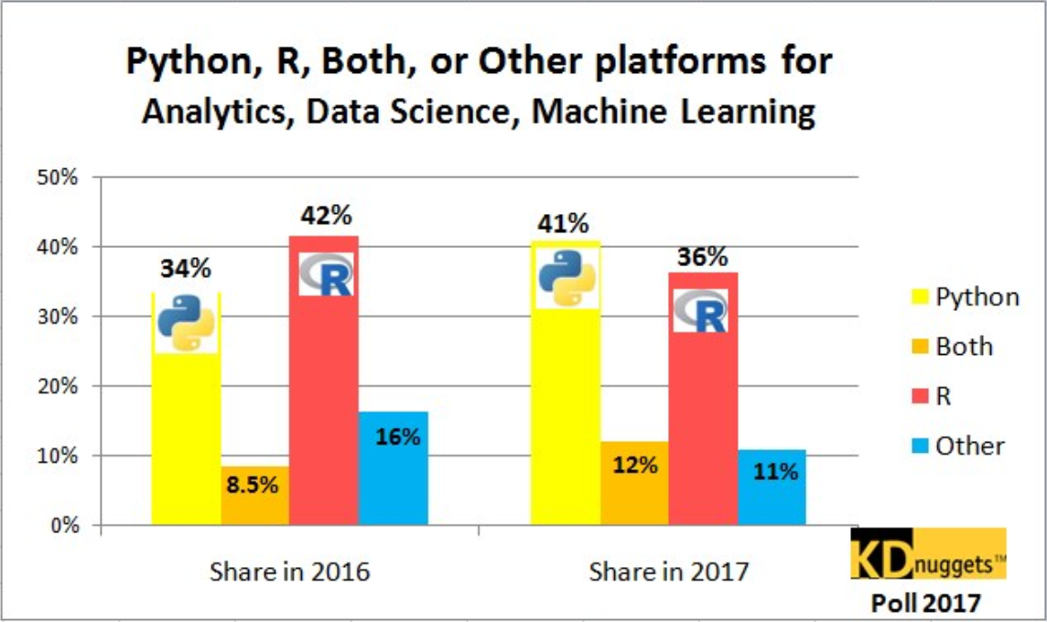







Why Python?
Popularity
Productivity
Interoperability
Scientific Python ecosystem
Community

Slide 6
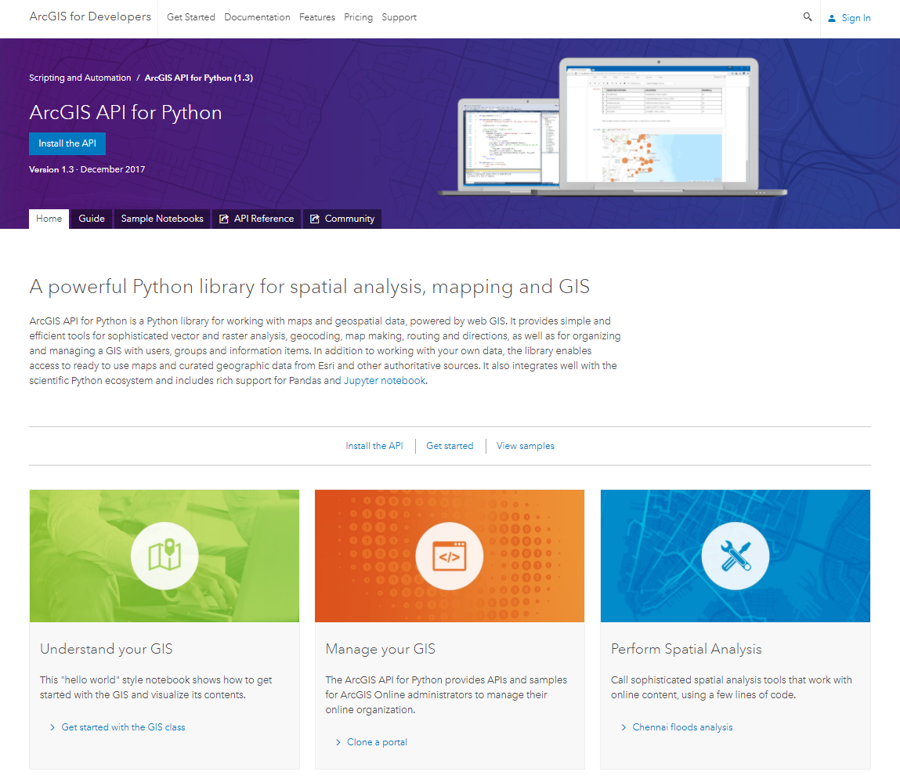

geo
enrichment
widgets
geometry
mapping
gis
geo
processing
geocoding
geo
analytics
realtime
schematics
raster
network
features

Slide 7
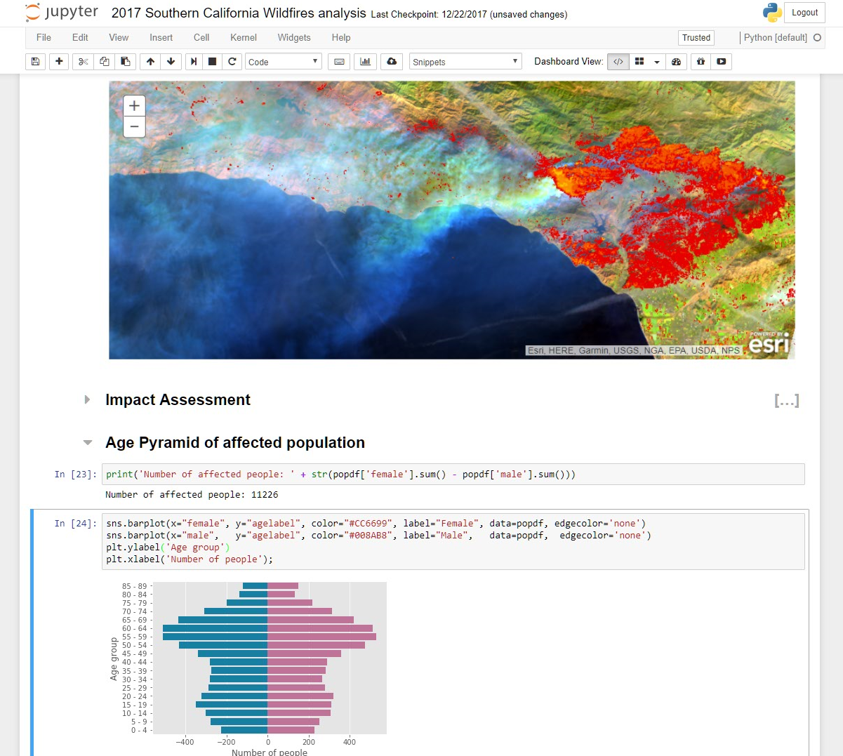
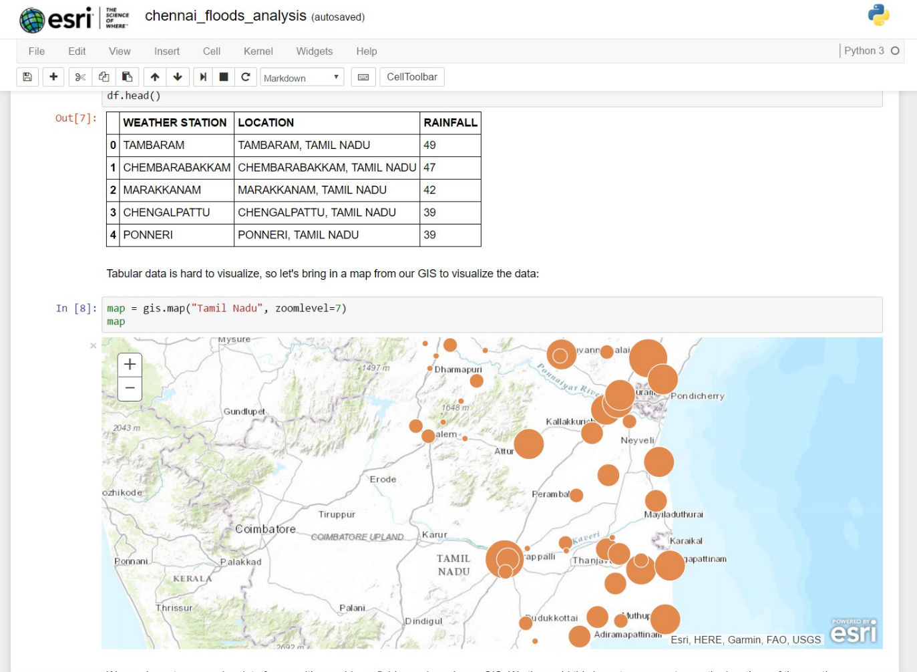
ArcGIS + Jupyter = ♥

Slide 8

Demo: “Hello Map”

Slide 9
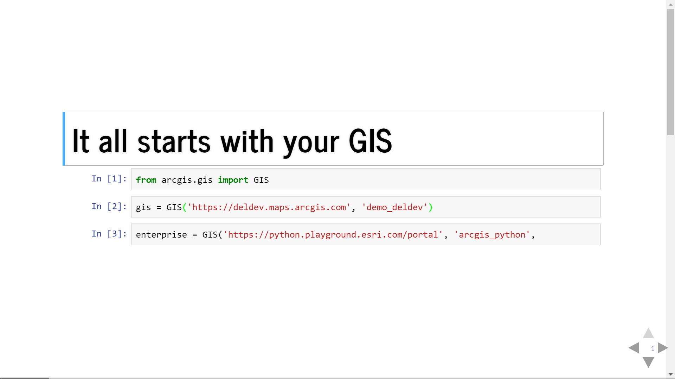

Slide 10
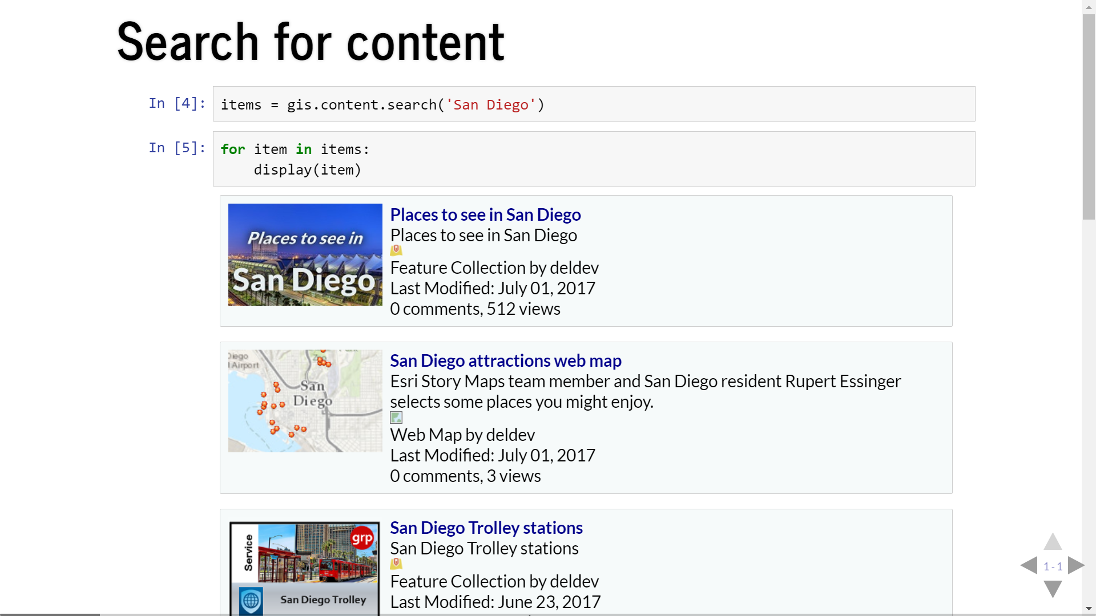

Slide 11
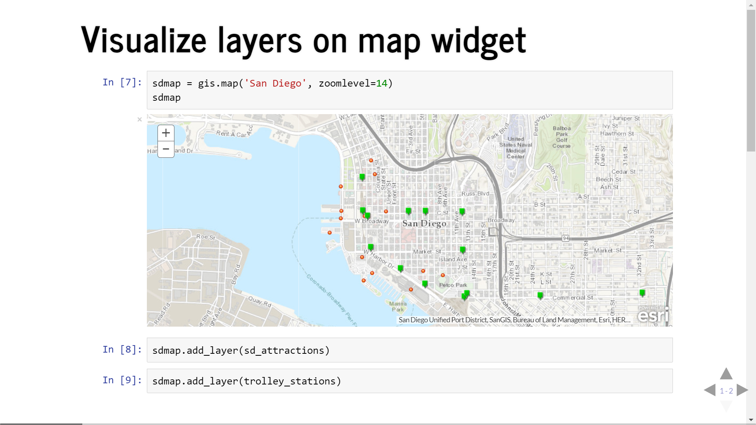

Slide 12
“The Language of Spatial Analysis”

Slide 13
Exploring your data…

Slide 14
Spatial DataFrame
Feature layers as a Pandas dataframe
arcgis.features.SpatialDataFrame class

Slide 15

What is a Spatial Data Frame?
Built on Pandas
Easy to Update, Query and Add New Content
Quickly visualize data

Slide 16
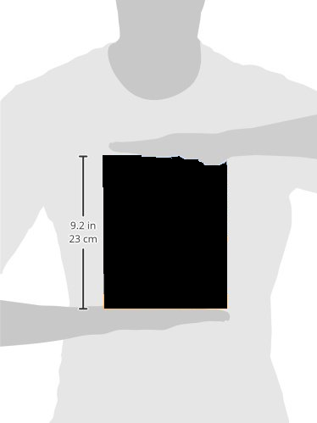

Benefits of Spatial Data Frame
All the benefits of Pandas Dataframes, but now with geometry!
Packs large datasets into memory efficiently
Powerful .groupby operations
Spatial Indexing
Consumes multiple data formats

Slide 17
Geometry Engine Support
ArcPy
Shapely
Data Reader Support
ArcPy
Fiona
pyshp

Slide 18
Demo: Flight Paths
Using Spatial DataFrame

Slide 19
Spatial Dataframes: Source Data Methods
Source data methods:
.from_csv
.from_df
.from_dict
.from_featureclass!
.from_layer!

Slide 20
Spatial Dataframes: Target Data Methods
Target data methods:
.to_clipboard
.to_csv
.to_dense
.to_dict
.to_excel
.to_feather
.to_json
.to_featureclass!
.to_featurelayer!
.to_featureset
.to_html
.to_pickle
.to_records

Slide 21
Spatial Dataframes: Other “Must-Know” Methods
Querying:
.loc
.iloc
.query
.geometry
.geometry_type
.get_value
.get_values
.groupby
.merge
.merge_datasets
.memory_usage
.setindex / .reset_index
.set_geometry
.shape
.spatial_reference
Inherent DF analysis methods:
.kurtosis
Many others…

Slide 22
Analyze and Model…

Slide 23
WebGIS Spatial Analysis
Six categories of tools from your GIS
arcgis.feature submodules

Slide 24
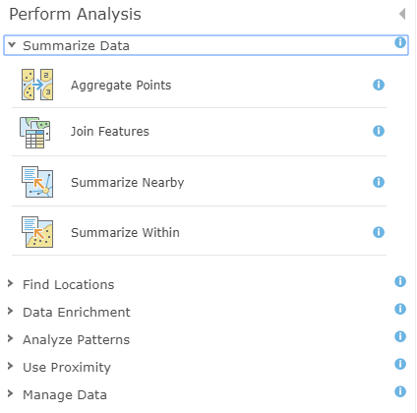
Spatial Analysis Tools
Summarize Data
Find Locations
Data Enrichment
Analyze Patterns
Use Proximity
Manage Data

Slide 25
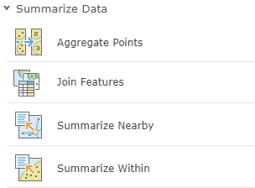
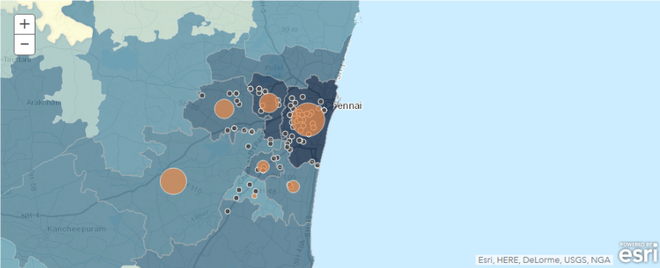
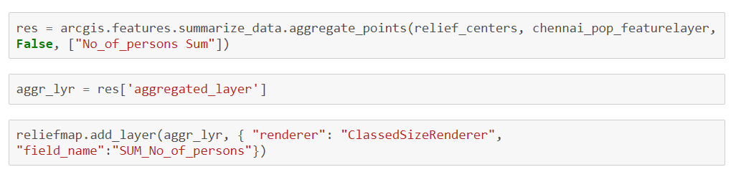
Summarize Data
Calculate summary statistics for features and attributes

Slide 26
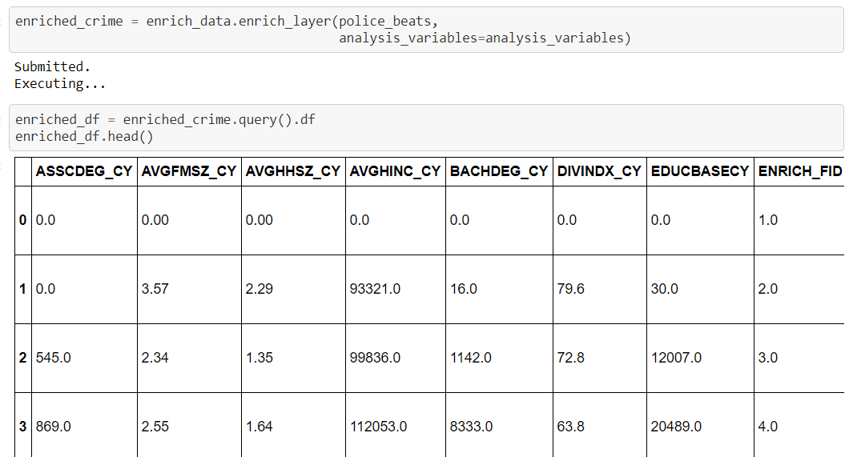
Enrich Layer
Add detailed demographic data and statistics to your analysis

Slide 27
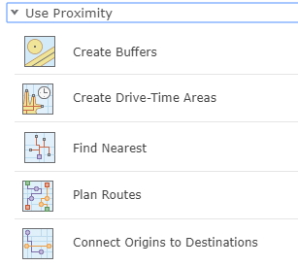
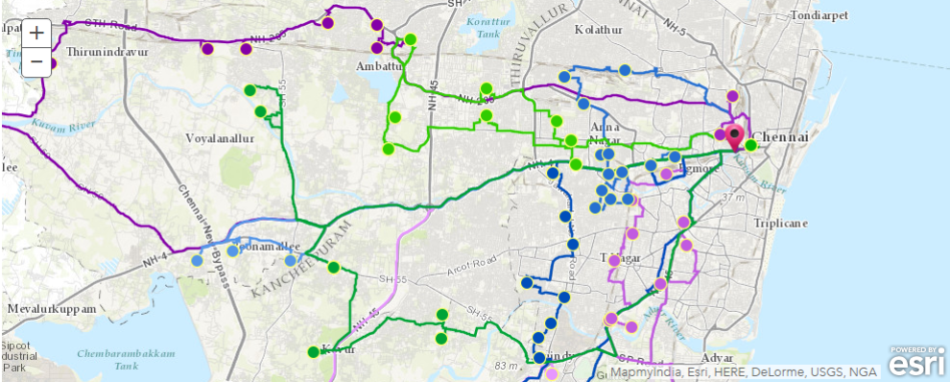
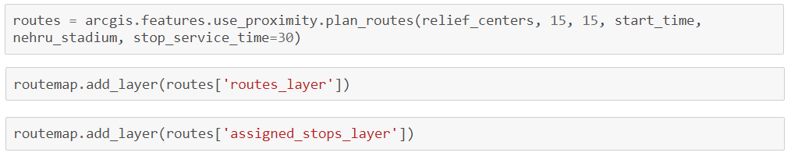
Use Proximity
“What is near what?”

Slide 28
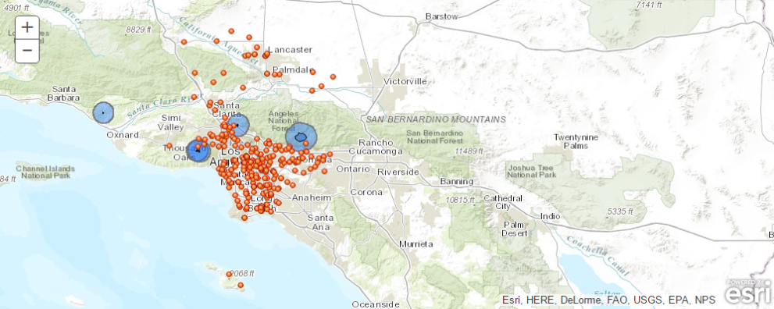
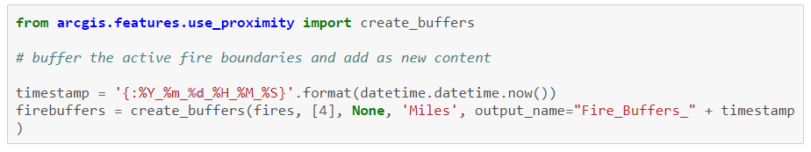
Use Proximity
“What is near what?”

Slide 29
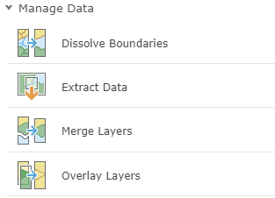
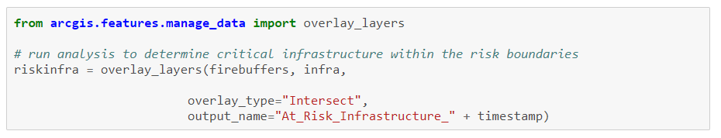
Manage Data
Manage geographic data, overlay layers

Slide 30
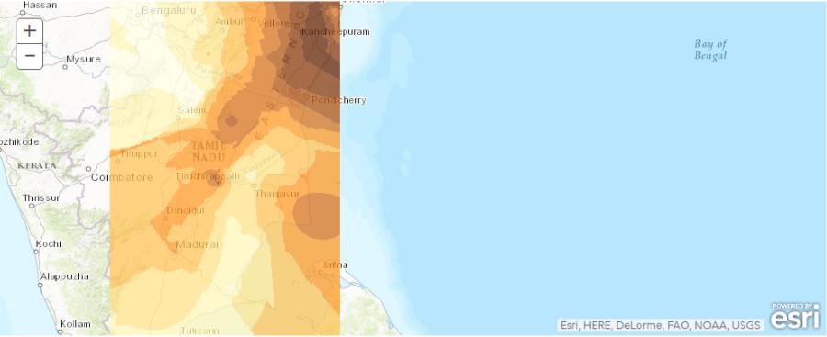
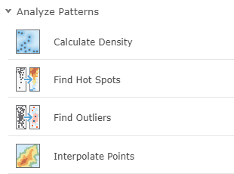
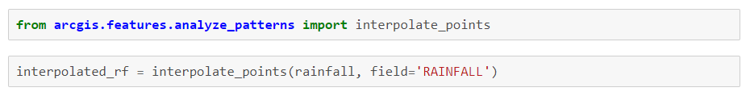
Analyze Patterns
Identify, quantify, and visualize spatial patterns in your data.

Slide 31
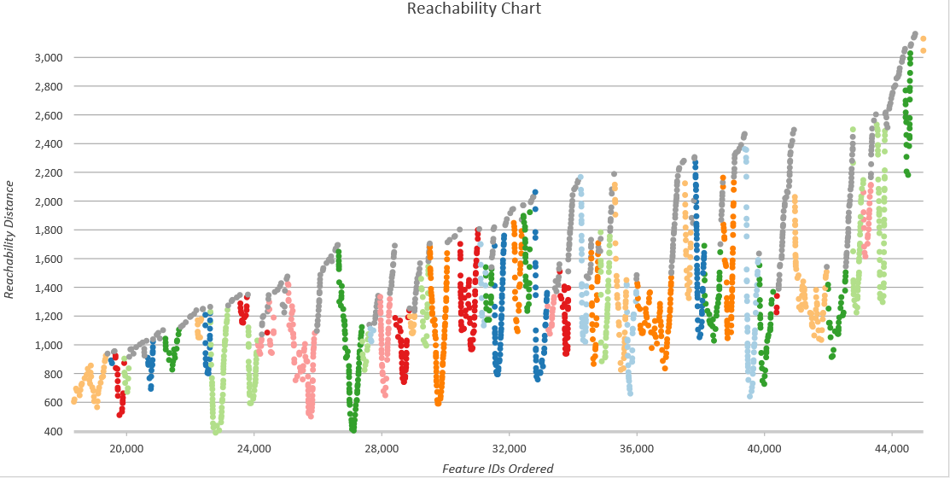
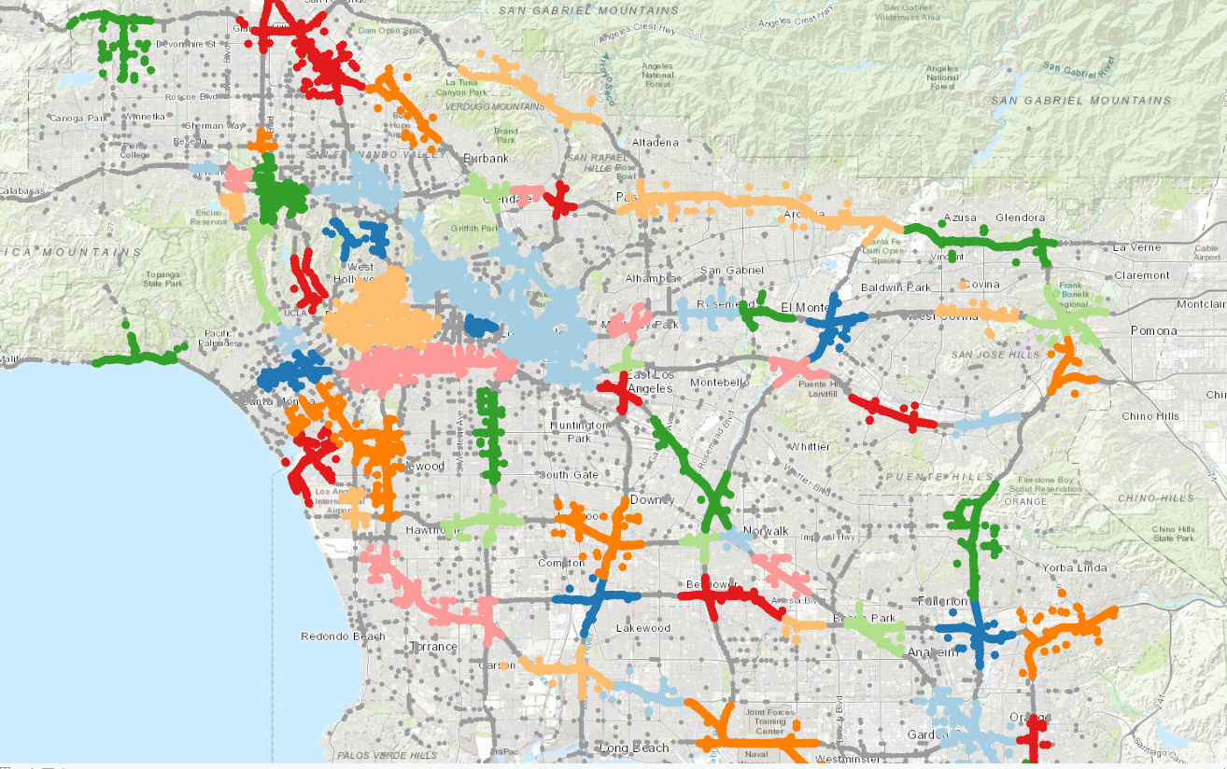
Spatial Analysis Tools
Other tools coming!
Density-based Clustering (DBSCAN, HDBSCAN)

Slide 32
Geocoding
Geocoding, Batch geocoding, reverse geocoding
arcgis.geocoding module

Slide 33
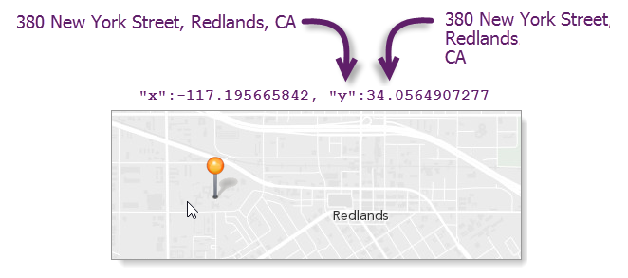
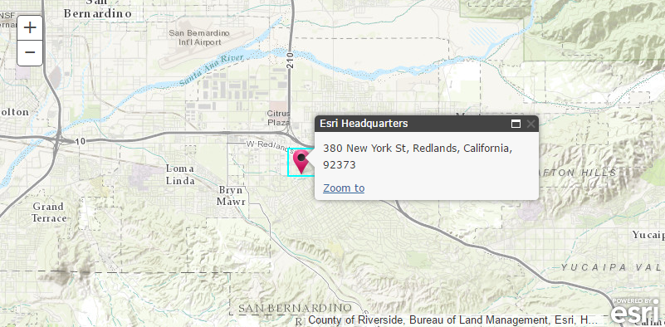
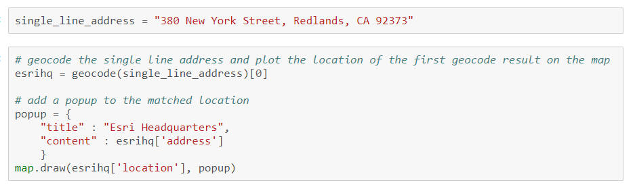
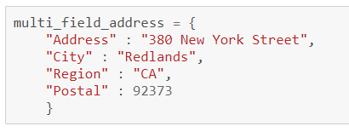
Geocode
Single line or multi field addresses

Slide 34
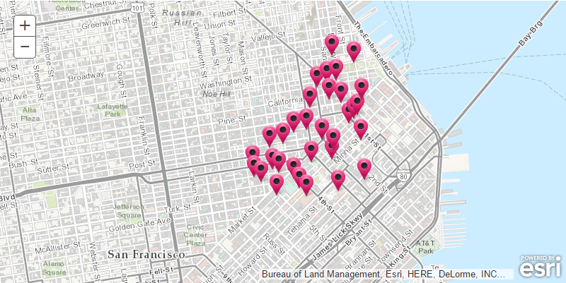
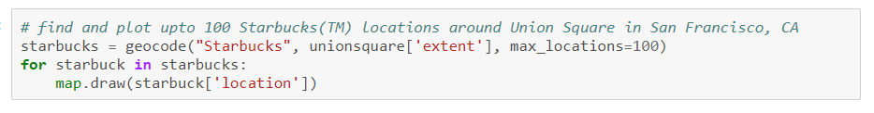
Geocode
Points of Interest
Cultural or geographic landmarks
Businesses by name or category
Administrative divisions

Slide 35
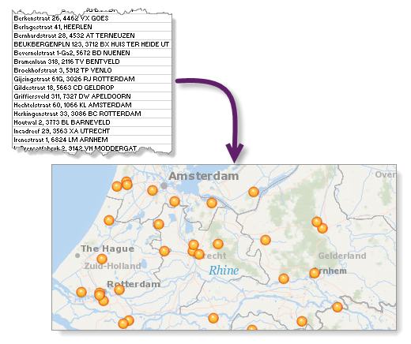
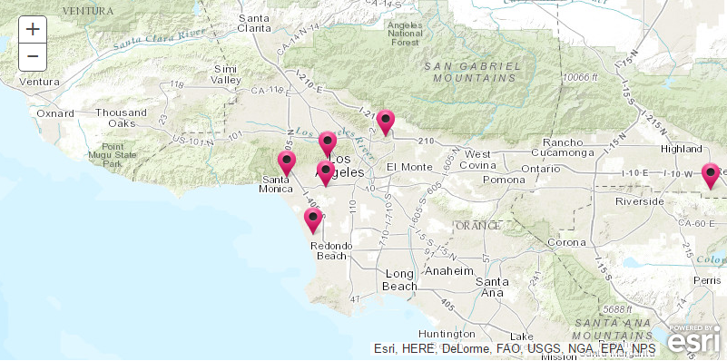
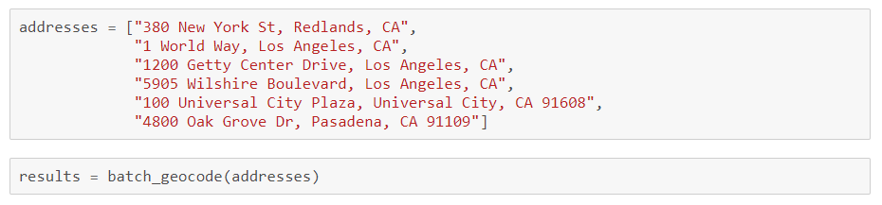
Batch Geocoding
Geocode an entire list of single line or multi field addresses

Slide 36
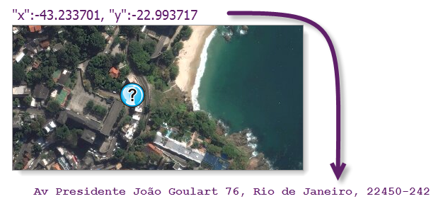
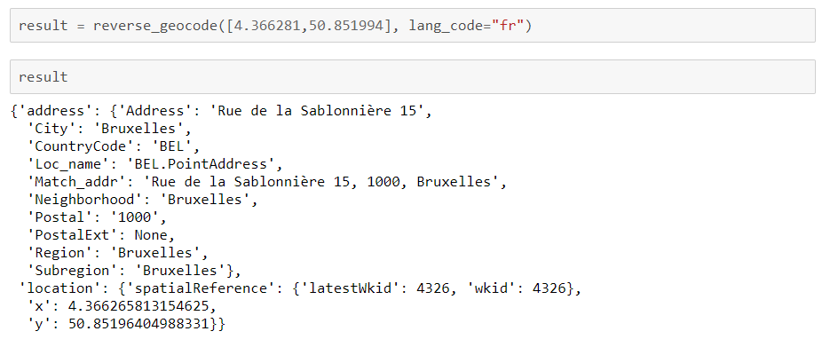
Reverse Geocode
Determines address at a particular x/y location

Slide 37
Network Analysis
Routing and directions, location allocation, service areas…
arcgis.network.analysis module

Slide 38
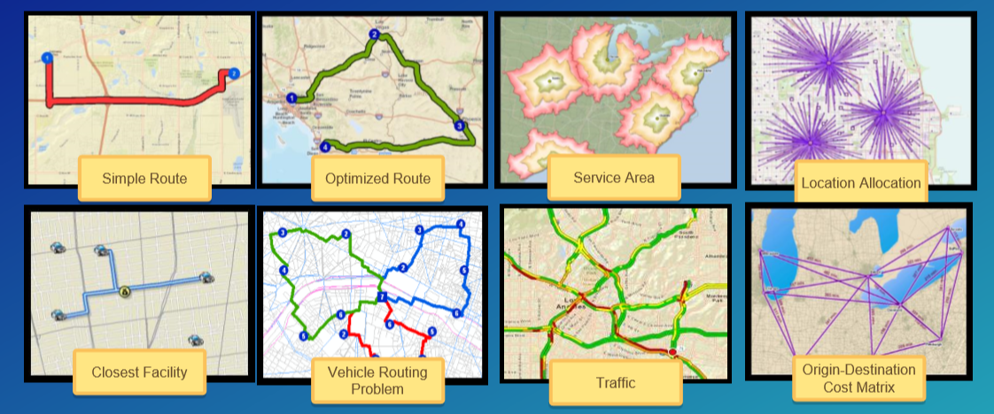
Network analysis capabilities and tools
Commercial grade, traffic aware routing and directions for multiple travel modes

Slide 39
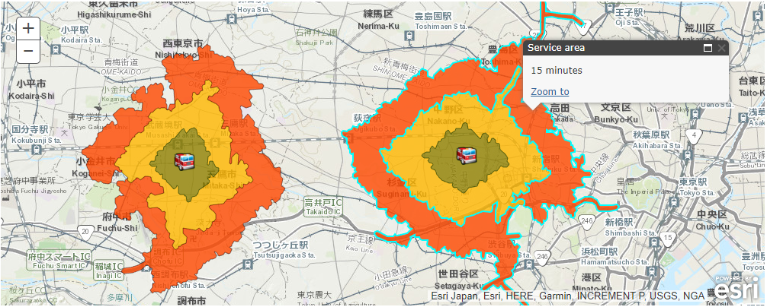
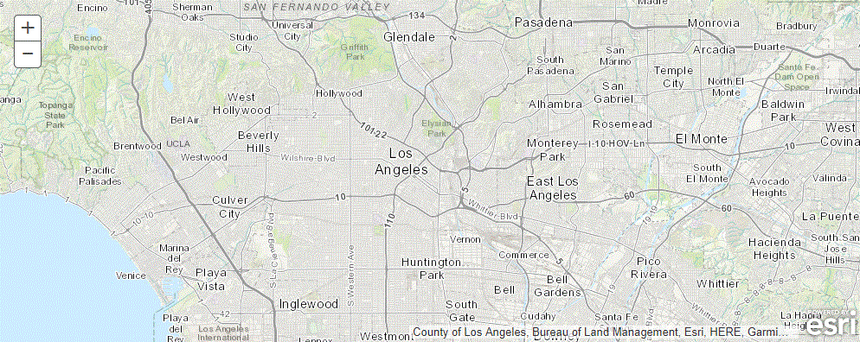
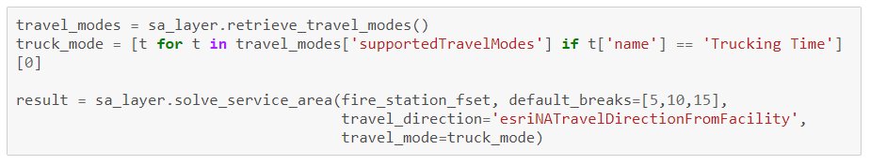
Network analysis – Service Areas

Slide 40
Demo: Finding Hospitals Closest to an Incident

Slide 41
GeoEnrichment
Enrich your analysis with demographic and business data
arcgis.geoenrichment module

Slide 42
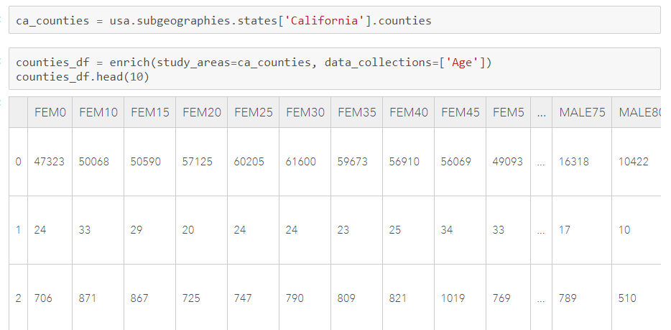
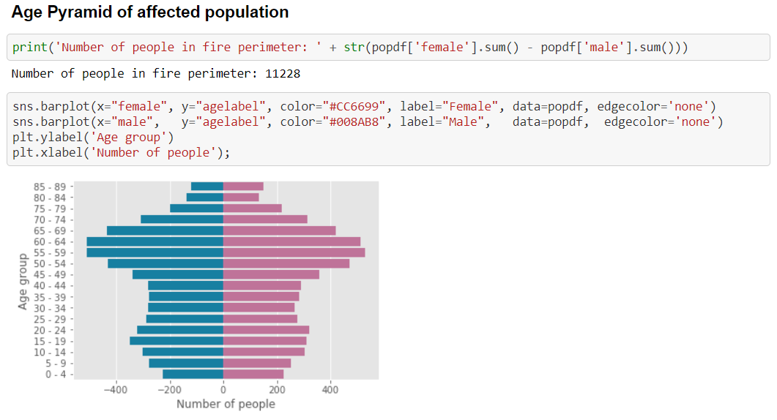
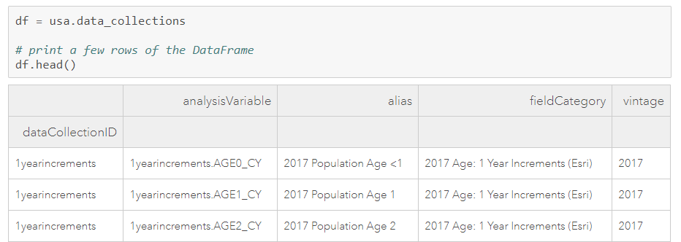
GeoEnrichment
Get facts about a location or area
Street addresses
Points, lines and polygon geometries
Within a drive time or service area
Named geographical areas
Counties or block groups in California
Districts and subdistricts in India
Create charts and choropleth maps

Slide 43
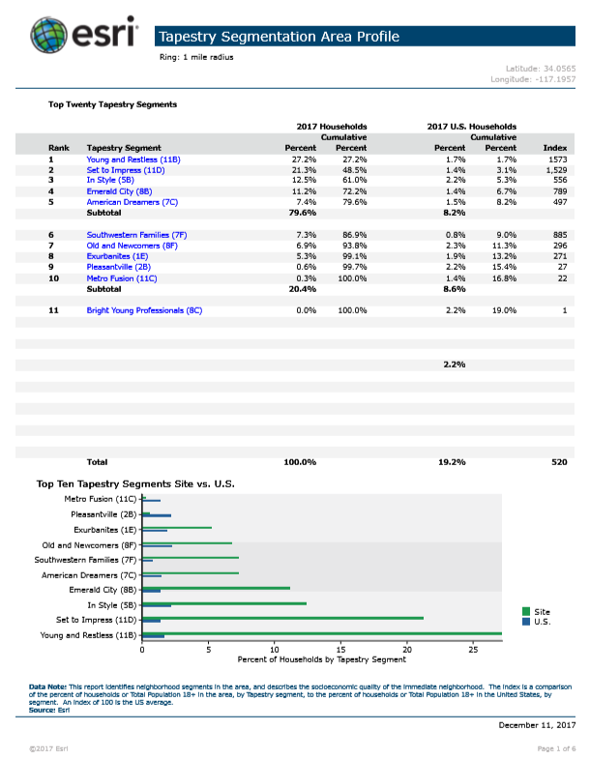
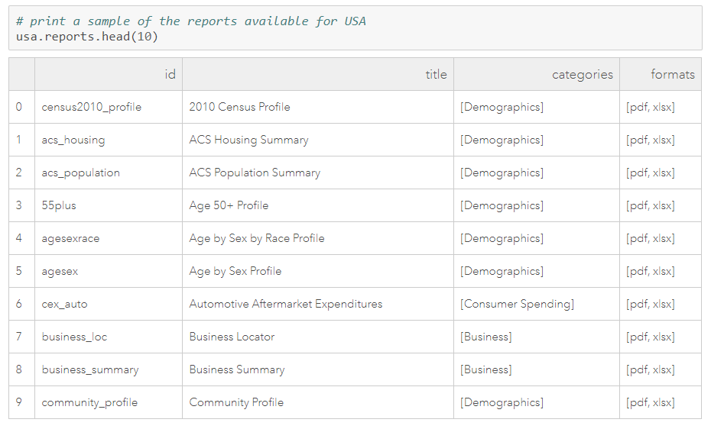
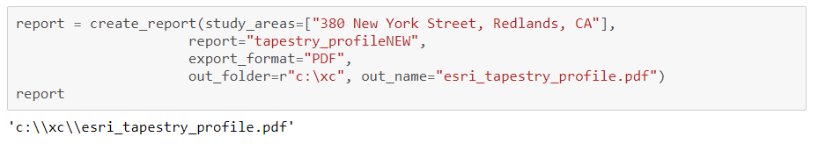
GeoEnrichment – create reports

Slide 44
Demo: GeoEnrichment

Slide 45
Data Collections: developers.arcgis.com/rest/geoenrichment/ api-reference/data-collections.htm

Slide 46
GeoAnalytics
Fast distributed spatio-temporal analysis of large vector and tabular data
arcgis.geoanalytics module

Slide 47
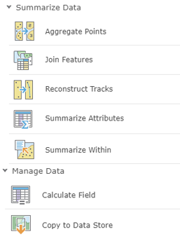

GeoAnalytics Tools
Summarize Data
Manage Data
Use Proximity
Find Locations
Analyze Patterns

Slide 48


Slide 49


Slide 50


Slide 51


Slide 52
Demo: Integration
Using the ArcGIS API for Python to integrate with other processes

Slide 53
Interpret your results…
Repeat as necessary…
Present the results…
Make a decision…

Slide 54
“The Language of Spatial Analysis”

Slide 56
developers.arcgis.com/python
anieto@esri.com

Slide 57
Questions?
Please fill out the surveys!

Slide 58






Please Take Our Survey in the Esri Events App
Download the Esri Events app and find your event
Select the session you attended
Scroll down to find the feedback section
Complete answers
and select “Submit”

Slide 59



